Slide 1
KATJA SCHRÖter
THE POSTMAN ALWAYS RINGS TWICE:
FROM THE GREAT DEPRESSION IN THE US TO EAST GERMANY
AFTER UNIFICATION

Slide 2
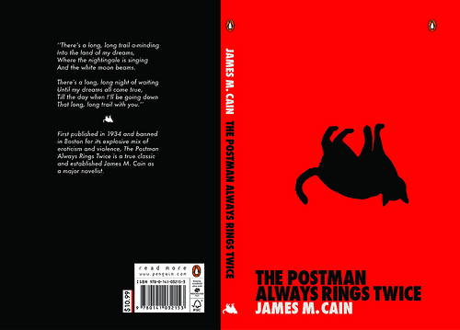
JAMES M. CAIN’S 1934 CONTROVERSIAL CRIME NOVEL

Slide 3
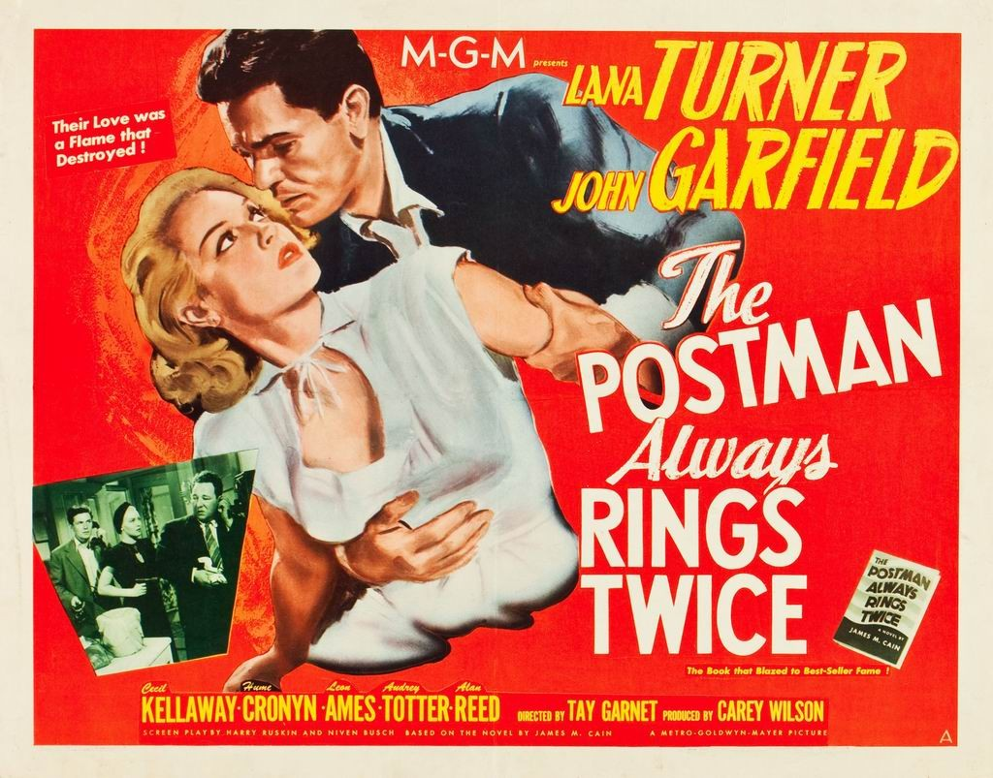
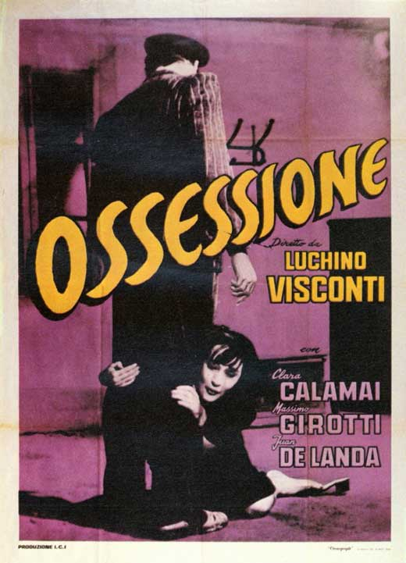
FILM ADAPTATIONS

Slide 5
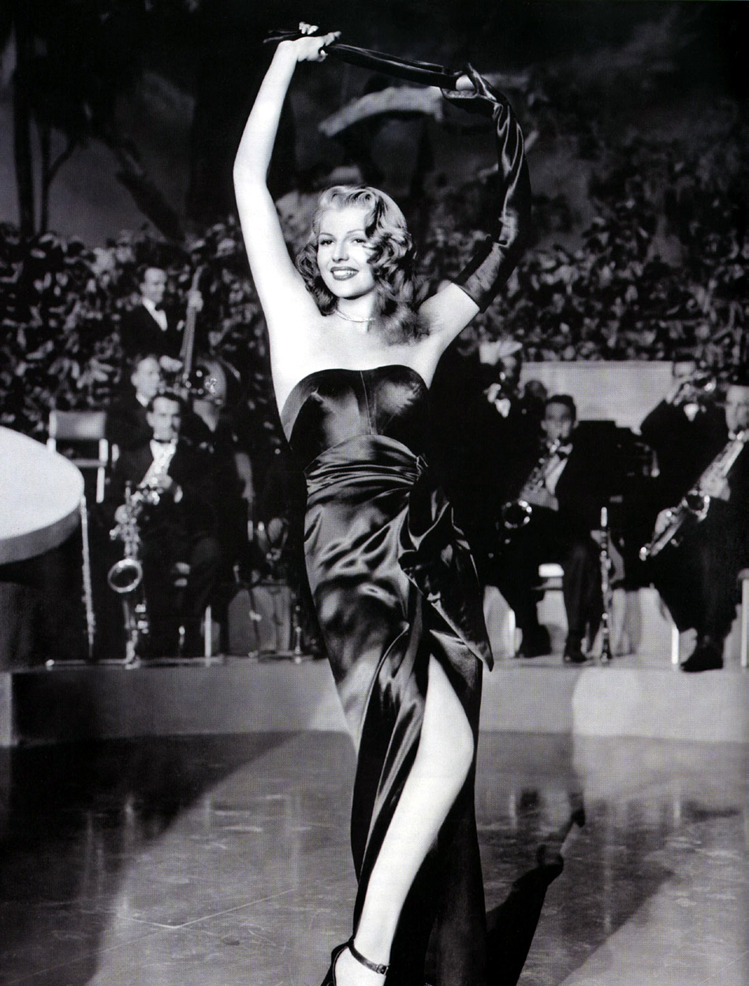
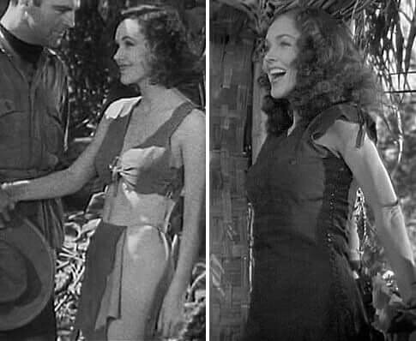
MOTION PICTURE CODE/HAYS CODE – 1930 – 1968 –
- SET OF MORAL GUIDELINES
GILDA (MARGARITA CARMEN CANSINO A.K.A. RITA HAYWORTH
IN GILDA BY CHARLES VIDOR (1946)
LEFT: JANE (MAUREEN O’SULLIVAN) I
TARZAN, THE APE MAN (1932)

Slide 6
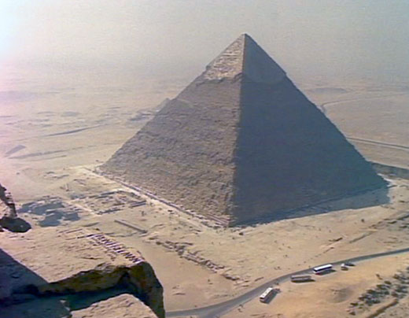
WHAT DID YOU LIKE BETTER? THE BOOK OR THE FILM?
FRENCH FILM THEORIST: ANDRÉ BAZIN (1948)
BY THE YEAR 2050 WE WILL NO LONGER THINK OF FILM AND LITERATURE AS CAUGHT UP IN DICHOTOMIES BUT RATHER AS A SINGLE WORK OF ART REFLECTED BY THREE DIFFERENT MEDIA, AKIN TO THE THREE SIDES OF A PYRAMID, WITH EACH OF EQUAL VALUE.

Slide 7
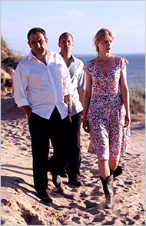
CLASSIFYING THE RELATIONSHIP BETWEEN LITERARY WORK AND ADAPTATION
FIDELITY
CRITICAL ENGAGEMENT WITH THE ORIGINAL
BORROWING FROM OR IN THE STYLE OF THE ORIGINAL

Slide 8
CHARACTER COMPARISON: BOOK AND FILMS
HUSBAND WIFE LOVER
NOVEL (1932) NICK PAPADAKIS CORA FRANK CHAMBERS
GREEK, “GREASY” FORMER PROST. “TRAMP”
NAÏVE WORRIED ABOUT “PUNK”
LOOKING “MEX”
FILM (1946) NICK SMITH CORA SMITH FRANK CHAMBERS
OLDER, CHUBBY ”FORMER ???” “TRAMP”
FILM (1981) NICK PAPADAKIS CORA SMITH FRANK CHAMBERS
JERICHOW (08) ALI ÖZKAN LAURA THOMAS
TURKISH DEBT 142000 EUROS FORMER
ESTABLISHED SOLDIER

Slide 9
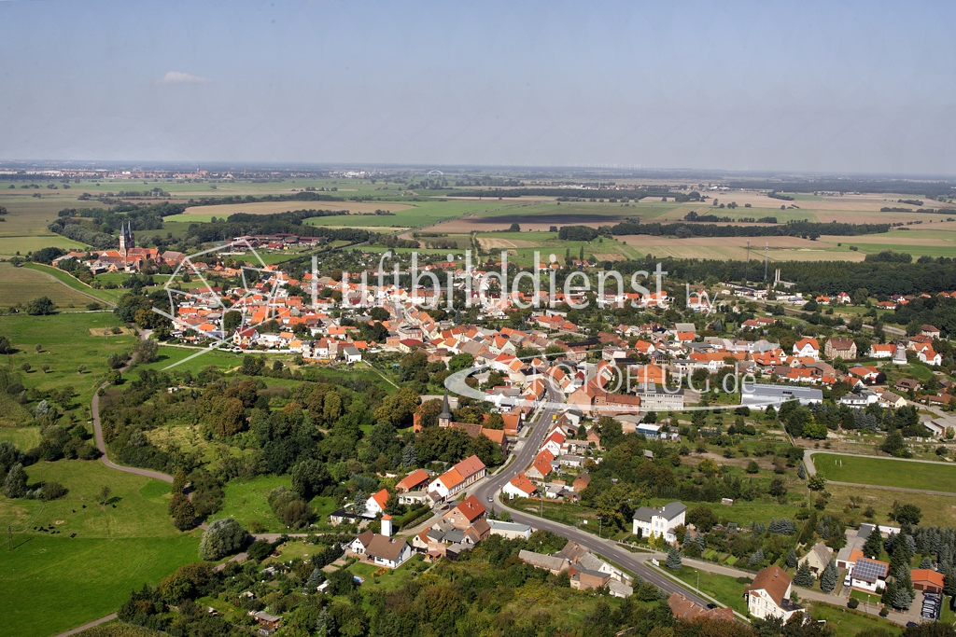
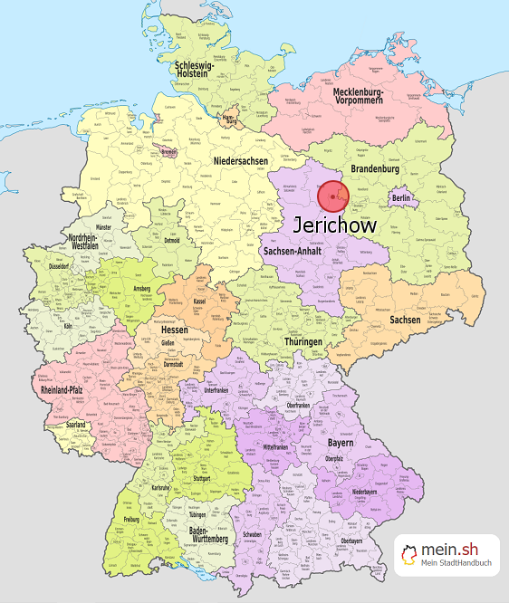
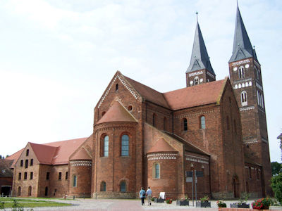
JERICHOW

Slide 10
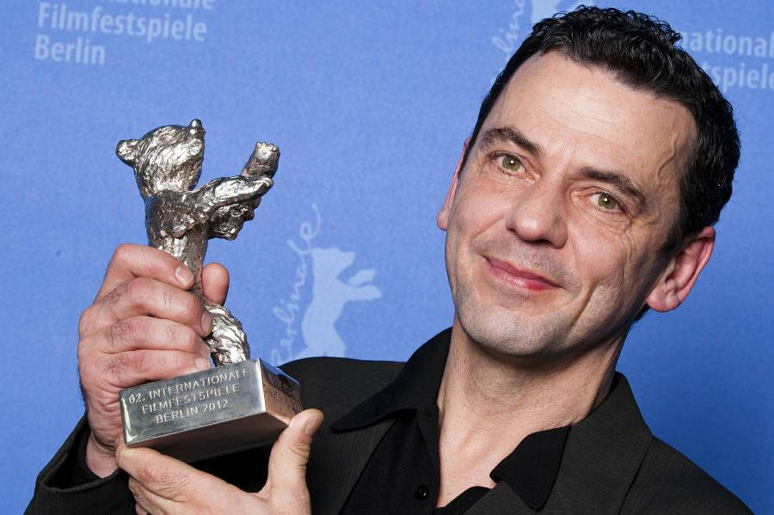
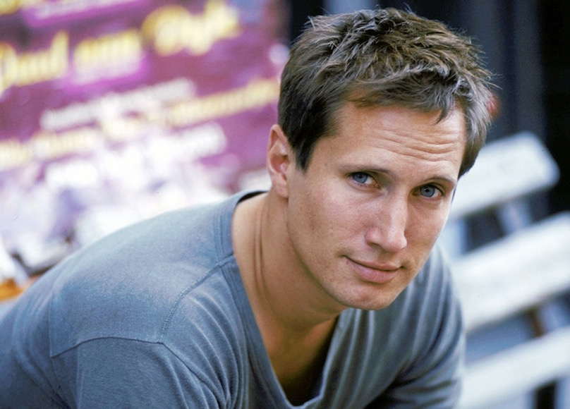
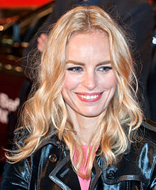
NINA HOSS – DIVA OF GERMAN FILM TODAY
CHRISTIAN PETZOLD
BERLIN FILM FESTIVAL 2012
SILVER BEAR FOR BARBARA
BENNO FÜRMANN -
THE “BRUCE WILLIS” OF GERMAN FILM

Slide 11
FILMS BY CHRISTIAN PETZOLD
2007
2014
2012

Slide 12
CHRISTIAN PETZOLD ABOUT HIS FILM
THE FILM ALSO FOCUSES ON THE NOTION OF HEIMAT.
WHEN PEOPLE USE THIS TERM IN GERMANY FOREIGNERS HAVE TO BE CAREFUL. THAT’S WHY I THOUGHT IT IMPORTANT THAT IT IS EXACTLY A TURK LIKE ALI WHO, IN THE MIDDLE OF SAXONY-ANHALT, HAS THE MONEY AND OWNS THE HOUSE AND THE COMPANY. CAIN’S NOVEL IS ABOUT A GREEK AS WELL. THAT RACISM PLAYS AN IMPORTANT ROLE IN THE NOVEL WAS NEVER PROPERLY ACKNOWLEDGED. THIS KIND OF RACISM IS HIDDEN - IN A TERRIBLE WAY – IN THE IDEA OF HEIMAT-BUILDING.

Slide 13
COMPARISON WAGES (SKILLED LABOR) EAST – WEST 2017!!!
AVERAGE: WESTERN GERMANY: 43000
highest: Hessia 47500
lowest: Schleswig-Holstein 36500
AVERAGE: EASTERN GERMANY: 34300
highest: Berlin 41200
2nd : Thuringia 33000
lowest: Mecklenburg-Vorpommern
30600

Slide 14
FUTURE OF
UNITED GERMANY?

