Slide 1
Keeping New Mexico from Becoming the Land of Entrapment Overcoming Adverse Childhood Experiences
andrew hsi, md, mph
director institute for resilience, health, and justice
principal investigator FOCUS and ADOBE programs at UNM HSC

Slide 2
Objectives for Presentation
At the conclusion, distinguished audience will recognize;
Impact of experiences Adverse Childhood Experiences (ACES)
Mechanisms to support early brain development
Approaches towards prevention and intervention
Two-generation approaches to reducing the effects of ACEs
Disclosures:
Discussion of family trauma is difficult and may cause audience stress
No actual family pictures used in this presentation
No financial interests to disclose

Slide 3
Entrapment in New Mexico
50th in Child Measures (Kids Count 2018)
48th children in poverty
31st for children not in school
49th for math proficiency in 8th grade
48th for disconnected youth
44th for teen birth rates (30 of 1000 births)
Statistics show a lot of young people are stuck here
Employers report “not enough qualified workers”
Loss of farm and production jobs
Youth not prepared for “Information Driven Economy”

Slide 4
Christi Starting FOCUS Clinic Care
18 years old
Buprenorphine in pregnancy
Opioid replacement
Behavioral health therapy
3 years oxycodone abuse
Marijuana and tobacco use
Has Medicaid insurance
Not employed
Father of baby inconsistent
geniuspregnancy.com

Slide 5
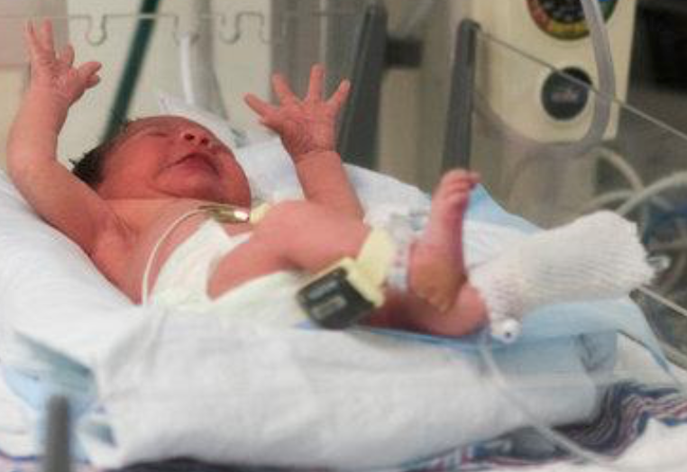
Christi Delivered Loretta
NOWS (NAS)
Hospital 14 days
NOWS withdrawal
Positive THC screen
Automatic CPS referral
CYFD investigation
No clear safety issues
Home with Christi
The New York Times

Slide 6
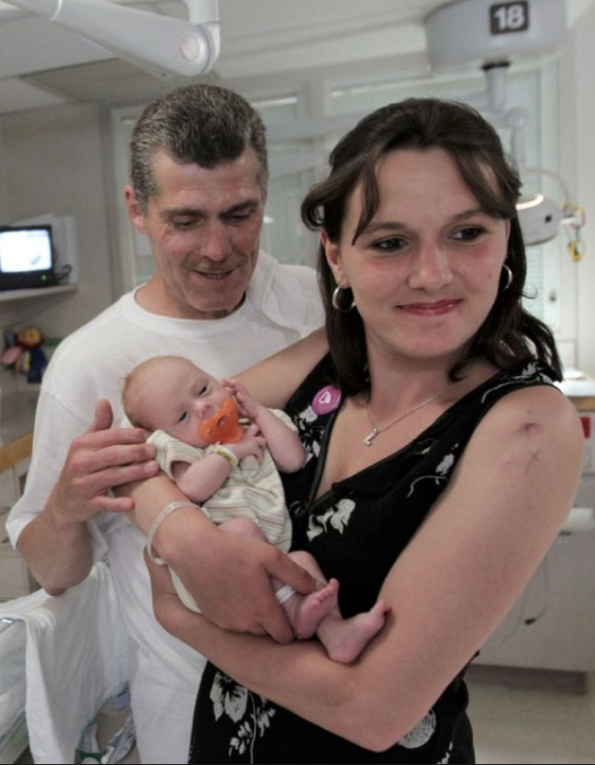
Christi and Loretta On Leaving Hospital
Alone in Albuquerque
Abusive home in rural town
Can’t return to family
Depression, untreated
Emotional paralysis
Loretta’s adversity
How to help?
thestar.com

Slide 7
Referrals Made For Christi
Attend drug treatment
Childcare
Transportation
Housing
Medical visits for Loretta
Would Christi
Accept her new role?
Would she relapse?
How did she get here?
aljazeera.com

Slide 8
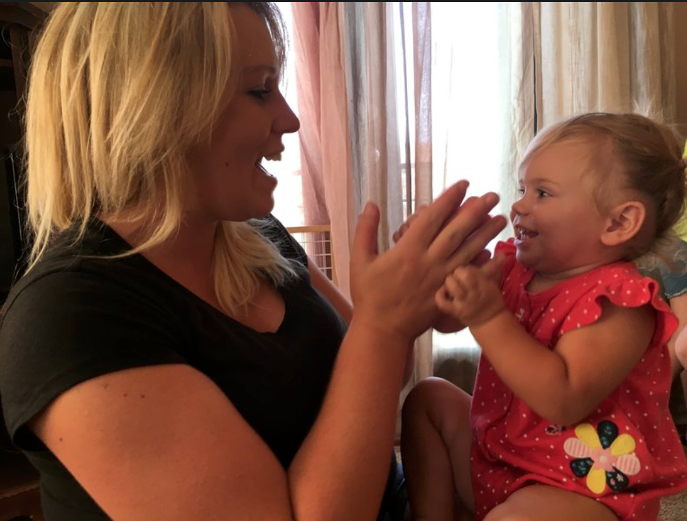
Christi As A Toddler 2000
Parents, Greg and Cheryl, had substance use
Alcohol
Then heroin
Greg in prison
Cheryl overdosed
Relative foster care
Neglect at 2 years
No permanency
How many ACEs?
npr.org

Slide 9
Study of ACEs Data by Kaiser Permanente and CDC Informs Us
Evaluation at Kaiser Health Appraisal Clinic in 1990’s
50,000 patients evaluated annually
Over every 4 years, 81% HMO members seen
Full medical, psychosocial, preventive evaluations
Survey of general health risk factors mailed to members
68% response rate of all patients evaluated
Survey questions included ACEs questions
17,337 of 18,175 completed mailed survey
Average age of those completing surveys was 56 years
Felitti, Anda, et al., 1998 and http://www.cdc.gov/ace/prevalence.htm

Slide 10
Definition of Adverse Childhood Experiences (ACEs)
Emotional Abuse
Emotional Neglect
Physical Neglect
Physical Abuse
Sexual Abuse
Directly affecting child from
Caretaker Abuse/Neglect
Creates risk of toxic stress
Household Dysfunctions
Home environment creating toxic stresses
Mother Treated Violently
Household Substance Abuse
Household Mental Illness
Parental Separation or Divorce
Incarcerated Household Member
Felitti VJ, Anda RF. Et al. “Relationship of Childhood Abuse and Household Dysfunction to Many of the Leading Causes of Death in Adults: The Adverse Childhood Experiences (ACE) Study.” 1999. Am J Prev Med.

Slide 11
ACEs: Relative Risks of Health Behaviors Associated with Risks for Early Death
* 0 adverse events set as standard referent risk
Felitti VJ, Anda RF. Et al. “Relationship of Childhood Abuse and Household Dysfunction to Many of the Leading Causes of Death in Adults: The Adverse Childhood Experiences (ACE) Study.” 1999. Am J Prev Med.

Slide 12
% of NM Adults Reporting an ACE, *Highest rate among states (NM, LA, AR, TN, WA)
New Mexico Behavioral Risk Factor Surveillance System, 2009. NM Department of Health. Prepared June 7, 2012.

Slide 13
Percent of New Mexico Adults* Aged >18 Years Reporting an ACE, by Number of ACEs Reported
*n=5,271 (randomly selected New Mexico residents).
**n=26,229 (includes randomly selected residents from AR, LA, NM, TN, and WA).
Adverse Childhood Experiences Report by Adults --- Five States, MMWR, December 17, 2010 / 59(49);1609-1613.

Slide 14
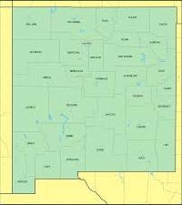
ACEs in New Mexico
Implications:
Elderly
Parents
School kids
Kids < 5
Professionals
60% of New Mexicans
have at least 1 ACE

Slide 15
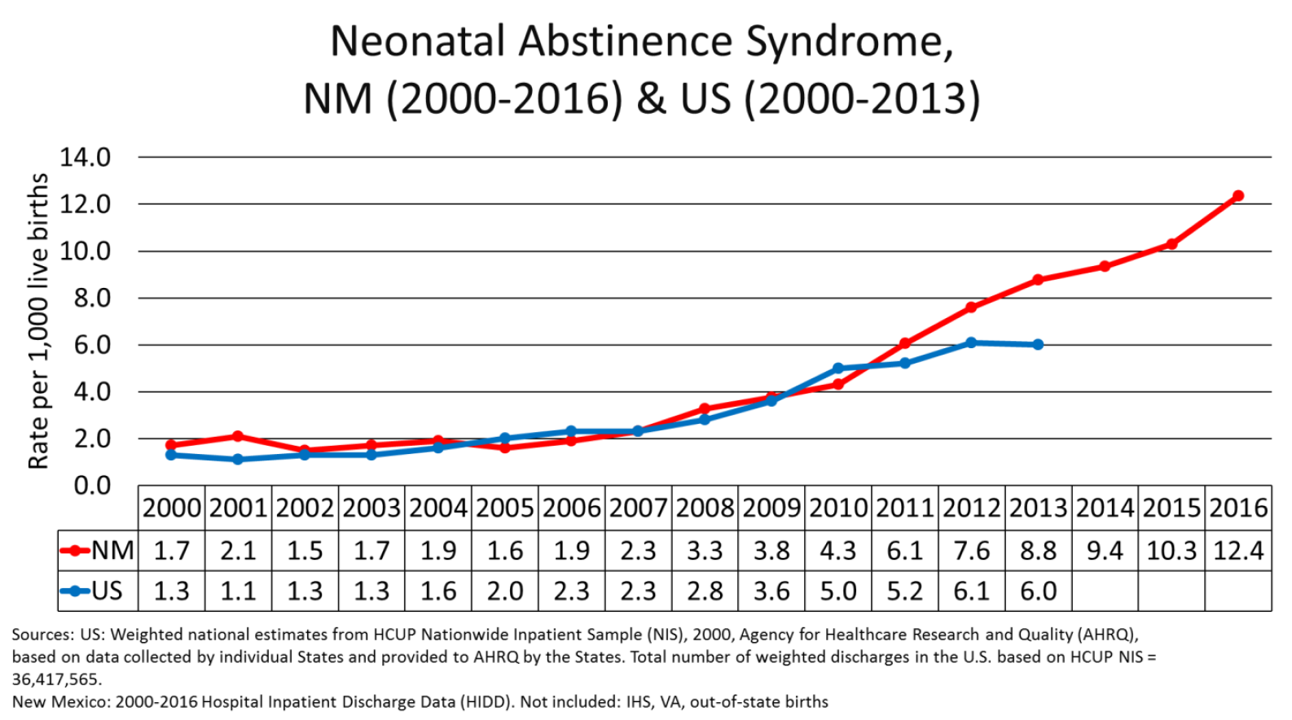
NOWS Trends NM and US
Neonatal Opioid Withdrawal Syndrome
Present Challenges for 25k births NM
Estimate 12 times 25 = 300 infants with NOWS
About half have diagnosis, so 600 with opioid exposure in pregnancy

Slide 16
Challenges for Christi and Loretta
New mom and baby, how to parent
Family support systems not dependable
Father of baby may not be involved
How to help Christi not use of psychoactive drugs
How to fully participate in drug treatment
What is meaning of recovery?
Support for the brain of Loretta
Long term developmental progress for both

Slide 17
Engagement and Height Change

Slide 18
Use of Cocaine, Crack, or Heroin by Engagement Level, First Year in FOCUS
% Mothers
Using
Crack,
Cocaine,
Heroin
Engagement as kept home visits, medical appointments, follow through on developmental recommendations
Babies’ Age in Quarters

Slide 19
Progress for Christi and Loretta
Christi learns to parent for Loretta’s development
Builds support systems who are dependable
Christi evaluates her use of psychoactive drugs
Continues Suboxone treatment for > 1 year
Full participation in treatment includes psychosocial
We learn Christi’s personal process of recovery
Christi plays with, reads to the brain of Loretta
Home team and medical see developmental progress

Slide 20
What About Earlier Prevention?
Prevention of ACES for family
Work with Christi is “secondary prevention”
Primary prevention for Loretta
Model of prevention before parenting
What populations might be helped?
Groups at risk of disparate outcomes
Infants and parents affected by prenatal substance use
Youth in the criminal justice system
Young people with disabling conditions, mental illnesses
Elderly at the end of life

Slide 21
Methods for ACEs Among Incarcerated Youth NM 2011-17
Published by NM Sentencing Commission
Extrapolated data from court-ordered multidisciplinary psychosocial assessments
Excluded family (household) member with a mental health illness
Used SPSS to create dataset and to analyze

Slide 25
Planned Services to Reduce Disparities
Minority groups incarcerated more
Females incarcerated had more ACEs
Youth return to family homes
Potential source of ACEs
Minority groups can’t access psychiatry
Insurance barriers,
6-12 weeks delay for next appointment
Transportation barrier
Too few psychiatrists, counselors, psychologists

Slide 26
Service Model for Two-Generations
ADOBE serves entire family system
Navigators understand home conditions, housing
Educational liaisons understand educational needs
Primary medical; psychiatrist does “drop in” visits
Psychologist provides counseling in primary clinic
Rx Suboxone for opioid substance use disorder
Legal assistance through UNM Law Clinic intakes

Slide 27
Navigation Services
Navigator assigned to each youth
Community health worker experiences
Staff with deep knowledge in community
Experience with youth at high-risk
Meet youth first at detention center
Support young person during incarceration
Present program services
Schedules first ADOBE Clinic visit
Enrolls youth in visit to family home
Address social determinant factors

Slide 28
Educational Supports
Educational Liaison Roles
Case manager expertise
Provides liaison role with family and school
Meet youth at school or clinic
Explores educational/vocational plans
Interface with school personnel
Support attendance, progress to graduation
GED program supports
Attend IEP, Behavioral meetings, staffings
Identifies better fit for education

Slide 29
July 18 – Dec 18 Medical Home
Notes:
These numbers are from July 2018-December 2018 and represent the total number of referrals ADOBE received in those 6 months. It also shows the number of youth we had enrolled as of December 31st. Lastly, 148 medical/psychiatric visits were made by our kids in that 6 month time.

Slide 30
Navigator Services Jul-Dec 2018

Slide 31
Educational Services Jul-Dec 2018

Slide 32
Data Summary ADOBE Feb 2019
Main outcome; prevent reincarceration
Follow through on conditions of release
No arrests after release
Total number of kids referred: 385
FY18: 141 youth in program navigation +
Out of 141 youth — 15 went back to YSC
Overall YSC: estimated rate of return 70%
ADOBE rate of return to detention: 9.4%
Family members accessing care

Slide 33
Issues of Recovery as Family; FOCUS and ADOBE
Expect parents to make changes
Become appropriate advocates
Normalize daily activity schedule
Take medication daily
Attend counseling, learn new ways
Apply learning to tomorrow
Apply learning to parent roles
Requires system to change
Build willingness to engage with family
Commit to continuity by providers

Slide 34
Policy to Prevent ACEs
Passage of House Bill 230 on 3 April
Bill changed Children’s Code by:
No automatic referral for substance use to child protection and law enforcement
Hospitals shall evaluate for “safety of infant”
Hospitals will refer is infant’s safety at risk
Hospitals will create a medical Plan of Care
Plan will document services for mother after discharge
Plan will have services for infant’s health and development
Insurance carriers will facilitate access to services
Mother (family) signs Plans of Care

Slide 35
How Policy Prevents ACEs
For Christi;
Helps Christi stay in behavioral health treatment
Prevents interruption of Suboxone treatment
Organizes primary care for Christi, whole health
For Loretta;
Decreases growing up with parent using drugs
This decreased “parenting under the influence”
Organizes developmental support for Loretta’s brain
Prevents hospitals from discriminating
Goal will be behavioral health referrals in pregnancy

Slide 36
Key Agenda for Healthy Children
Prevent Adverse Childhood Experiences
Prevent child neglect
Prevent prenatal alcohol and drug exposure
No parenting under the influence of alcohol or drugs; other stuff
Meet all needs for a child instead of all wants
Reduce the effects of Adverse Childhood Experiences
Early behavioral and mental health care for young children
Women and men must prevent unintended pregnancy
Each parent must provide at least half financial support
Resilient systems of care for parents and infants
Two generation models of survivor friendly care maintained
Notes:
The expected developmental challenges for young children with prenatal exposure, trauma and Adverse Childhood Experiences in the lives of the parents that contribute to early childhood development, and partnering with families to build resilient developmental outcomes.

Slide 37
Future Activities
HB230 asks for universal screening in pregnancy
Prenatal screening for substance use
Mental health conditions
Violence in homes
Screening for privately insured and Centennial
Insurance will recognize need of higher care level
Specialized care coordinators available for women
Facilitate access to behavioral health, drug treatment
Healthier pregnancies, less premature births
UNM wide “Family Well-Being” EMBRACE

Slide 38
Prevention of Entrapment
Create non-discriminating policies
Create infrastructure to address access issues
Behavioral health access based on insurance type
Facilitate primary care providers referring
Those needing treatment can start comprehensive care
Reduce risks for repeat incarceration
Support healthier (in large sense) outcomes
Support better educational development of children
Create greater opportunities in economy

Slide 39
Resources/references
Thank You for Your Interest
ahsi@salud.unm.edu
Felitti VJ, Anda RF. Et al. “Relationship of Childhood Abuse and Household Dysfunction to Many of the Leading Causes of Death in Adults: The Adverse Childhood Experiences (ACE) Study.” 199. Am J Prev Med.
Lori Zigich, MPH, Adverse Childhood Experiences (ACEs) of Youth Committed for Incarceration in New Mexico. August 24, 2017
Adverse Childhood Experiences Report by Adults --- Five States, MMWR, December 17, 2010 / 59(49);1609-1613.
ADOBE Annual Report, Bernalillo County ACEs Prevention Programs, Behavioral Health Services
Cannon Y, Davis G, Hsi, A, Bochte A in conjunction with the New Mexico Sentencing Commission. “Adverse Childhood Experiences in the New Mexico Juvenile Justice Population.” 2016. Available at:
https://nmsc.unm.edu/reports/2016/adverse-childhood-experiences-in-the-new-mexico-juvenile-justice-population.pdf
*

