Slide 1
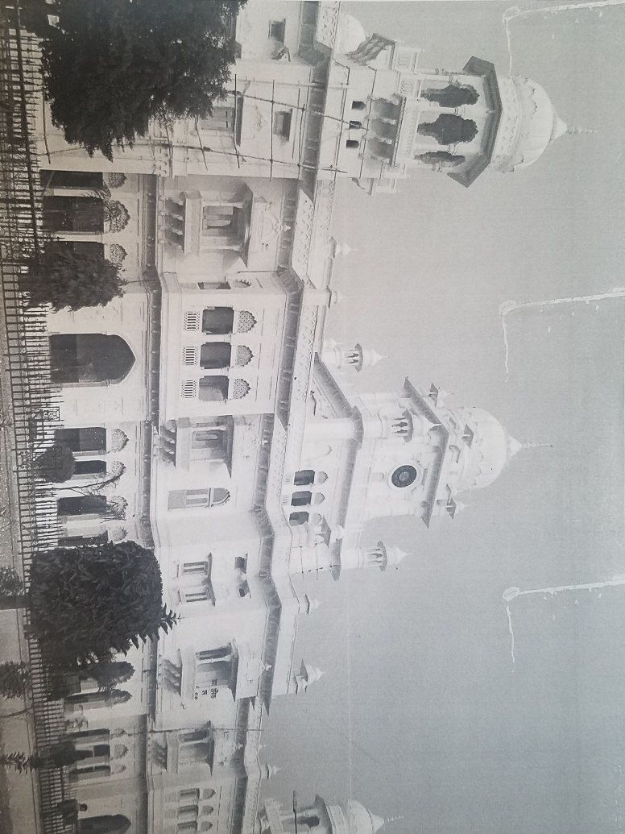

Slide 2
Doctor-Patient Relationship
Western Medicine
Untreatable Diseases
Less Emphasis on
  Social Aspects
  Epidemics

Slide 3
Learning Communication
Talking Honestly to Patients
Specialized but with General

Slide 4
War on Cancer
Followed the Fashion
Grants

Slide 5
Concern over Money as Motivator
Concern over Overtreatment

Slide 6
Overtreatment because of Hype
Overtreatment because of Doctor’s Mindset

Slide 7
Acceptance of Death
Concept of Failure
Care Versus Treatment
Teaching Communication

